Slide 1
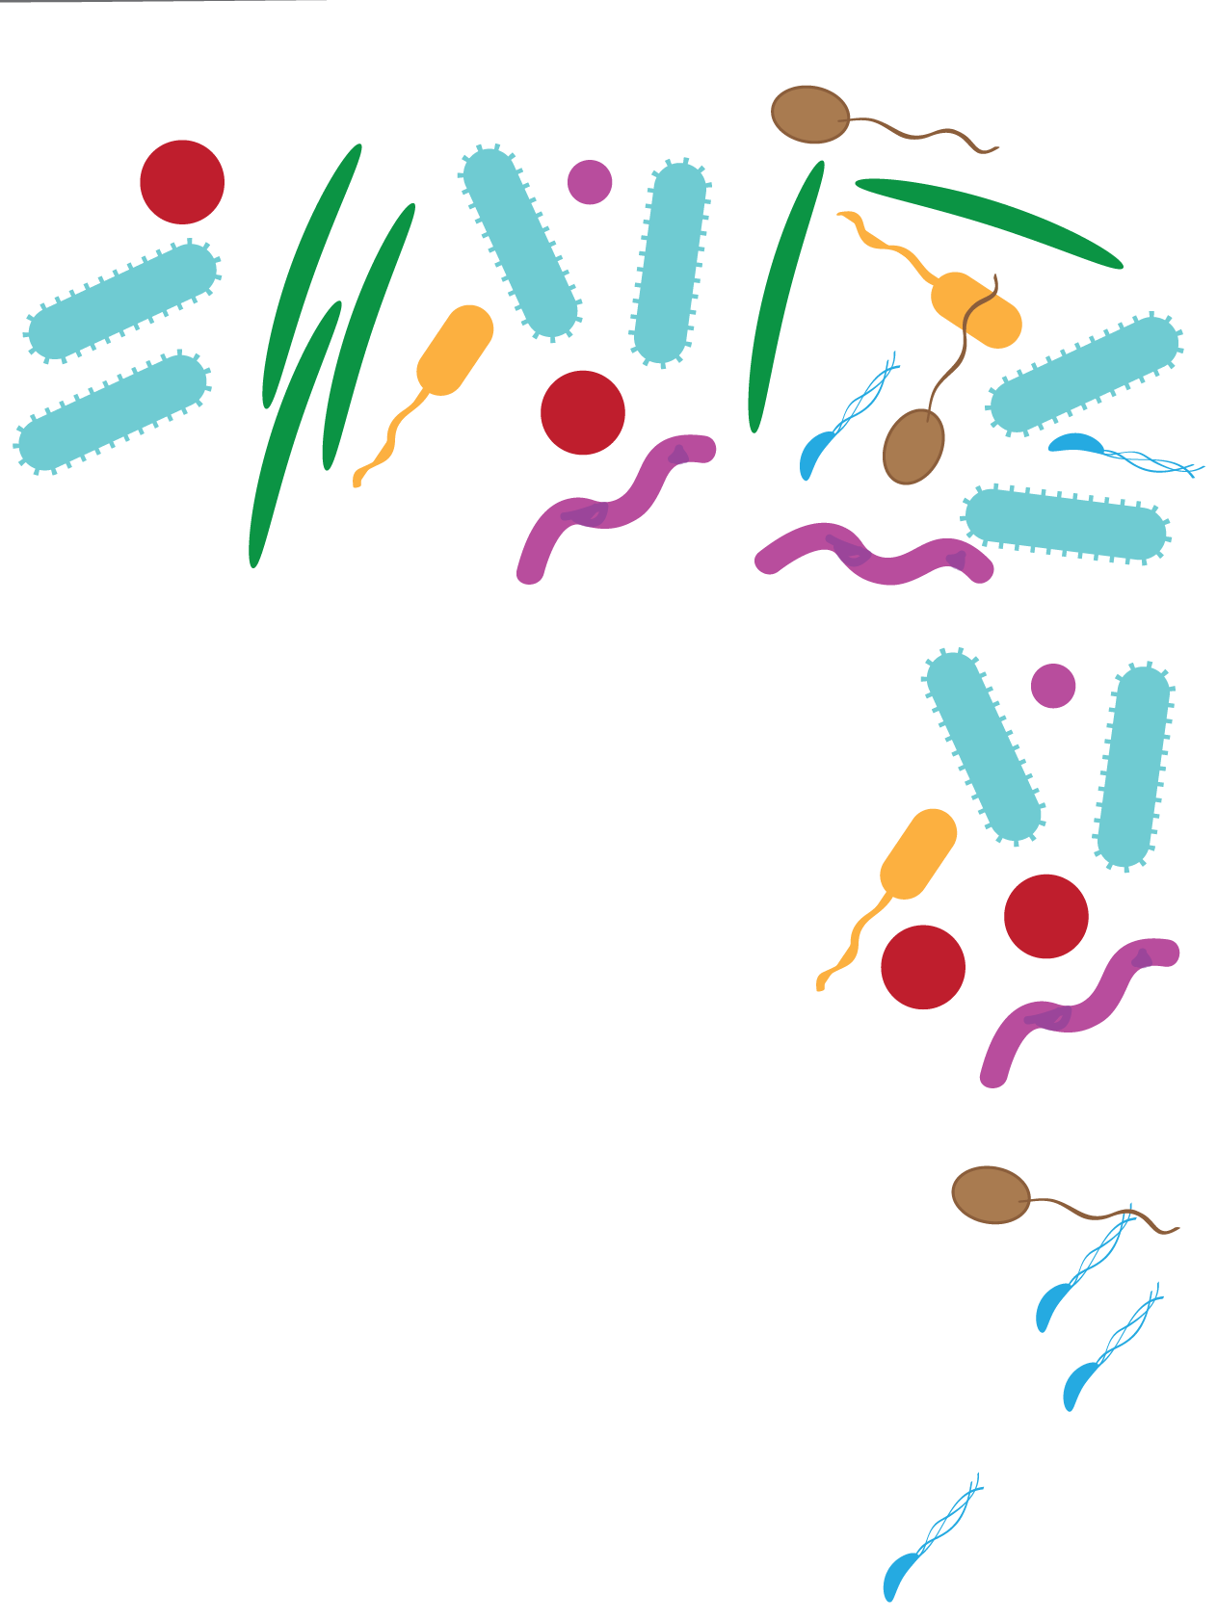
Computational Biology Patterns of microbial community change
Jesse Zaneveld

Slide 2
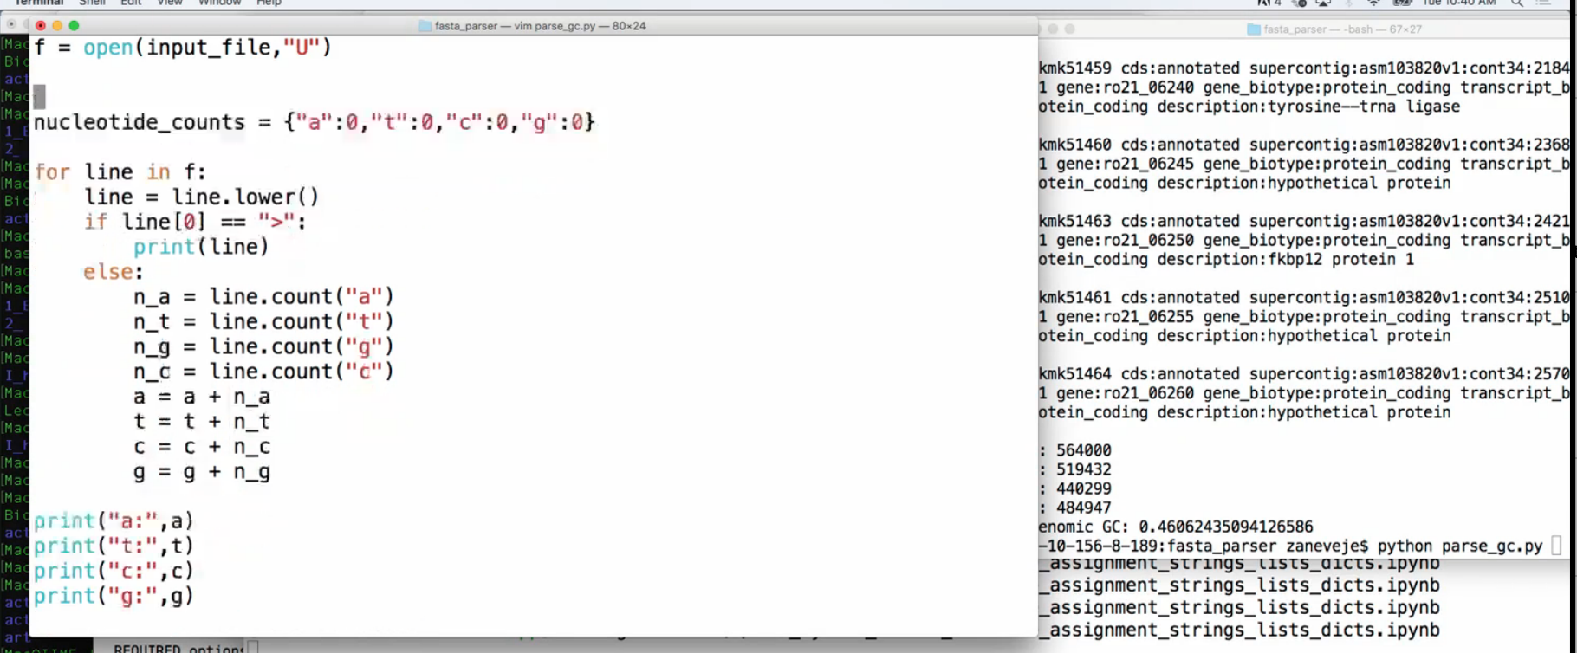
Python Scripts
Terminal 1 – Typing in Vim (or you could use Notepad,
Atom, Emacs, etc…) and saving to parse_gc.py
Terminal 2 – Actually running
the code by calling:
python parse_gc.py

Slide 3
Project 1 Proposals
By tonight please submit a project proposal for Project 1.
Project 1 will be a first chance to write your first complete python script. You only have a little while to finish the script. So you'll want to pick something limited in scope to start out with.
Here is what goes in to the Project 1 Proposal:
Overview
A short description of the purpose of the proposed script, why it is relevant or useful, and the output from running it (<250 words).
Inputs
A description of the program input (<300 words). What type of file(s) will your script need to be run on? Please include a link or short example of the format of the type of data that the script will process. How are entries separated?
Please try to actually download an example data file to make sure you can access one. You may find the list of biological databases here useful: https://en.wikipedia.org/wiki/List_of_biological_databases
Approach
A short (<250 word) description of how you plan to approach the problem.
Annotated References
Please cite at least 2 papers relevant to this project. For each, include the citation and 2-3 sentences describing how the paper will inform your project. For project 1 these can instead be references to python resources (e.g. the documentation for a new function or library you’ll be using).

Slide 4


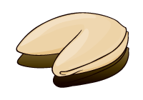
The Take Home
We can think about differences in microbial communities from several
perspectives, including specific pathogens, overall community composition,
cell counts, richness (α-diversity), and variability between sites or samples
(β-diversity)
At the same time, we can look at things from the point of view of microbes,
and check for signs of competition, cooperation, co-occurrence or mutual
exclusion.
Together these perspectives covers the core hypotheses of most
microbial ecology studies in medical and environmental applications
Source:
http://thechinabowl.com/wp-content/uploads/2015/04/Chinese_Fold-Pak_000.jpg
http://www.dezignwithaz.com/images/chinese-takeout-decal.png
http://www.trendus.com/images/hesaplamalar/fortunecookie_close.gif

Slide 5
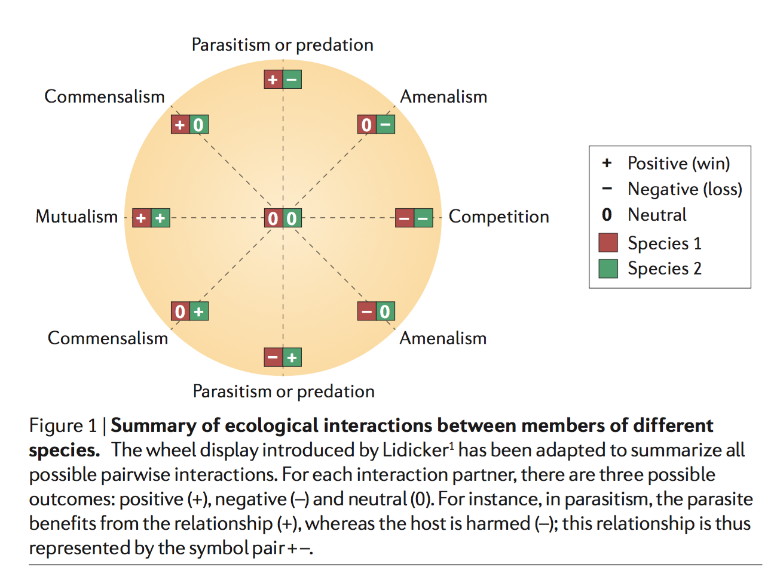
Microbe-microbe interactions
Source:
Faust and Raes, Nat. Reviews Micro, 2012

Slide 6
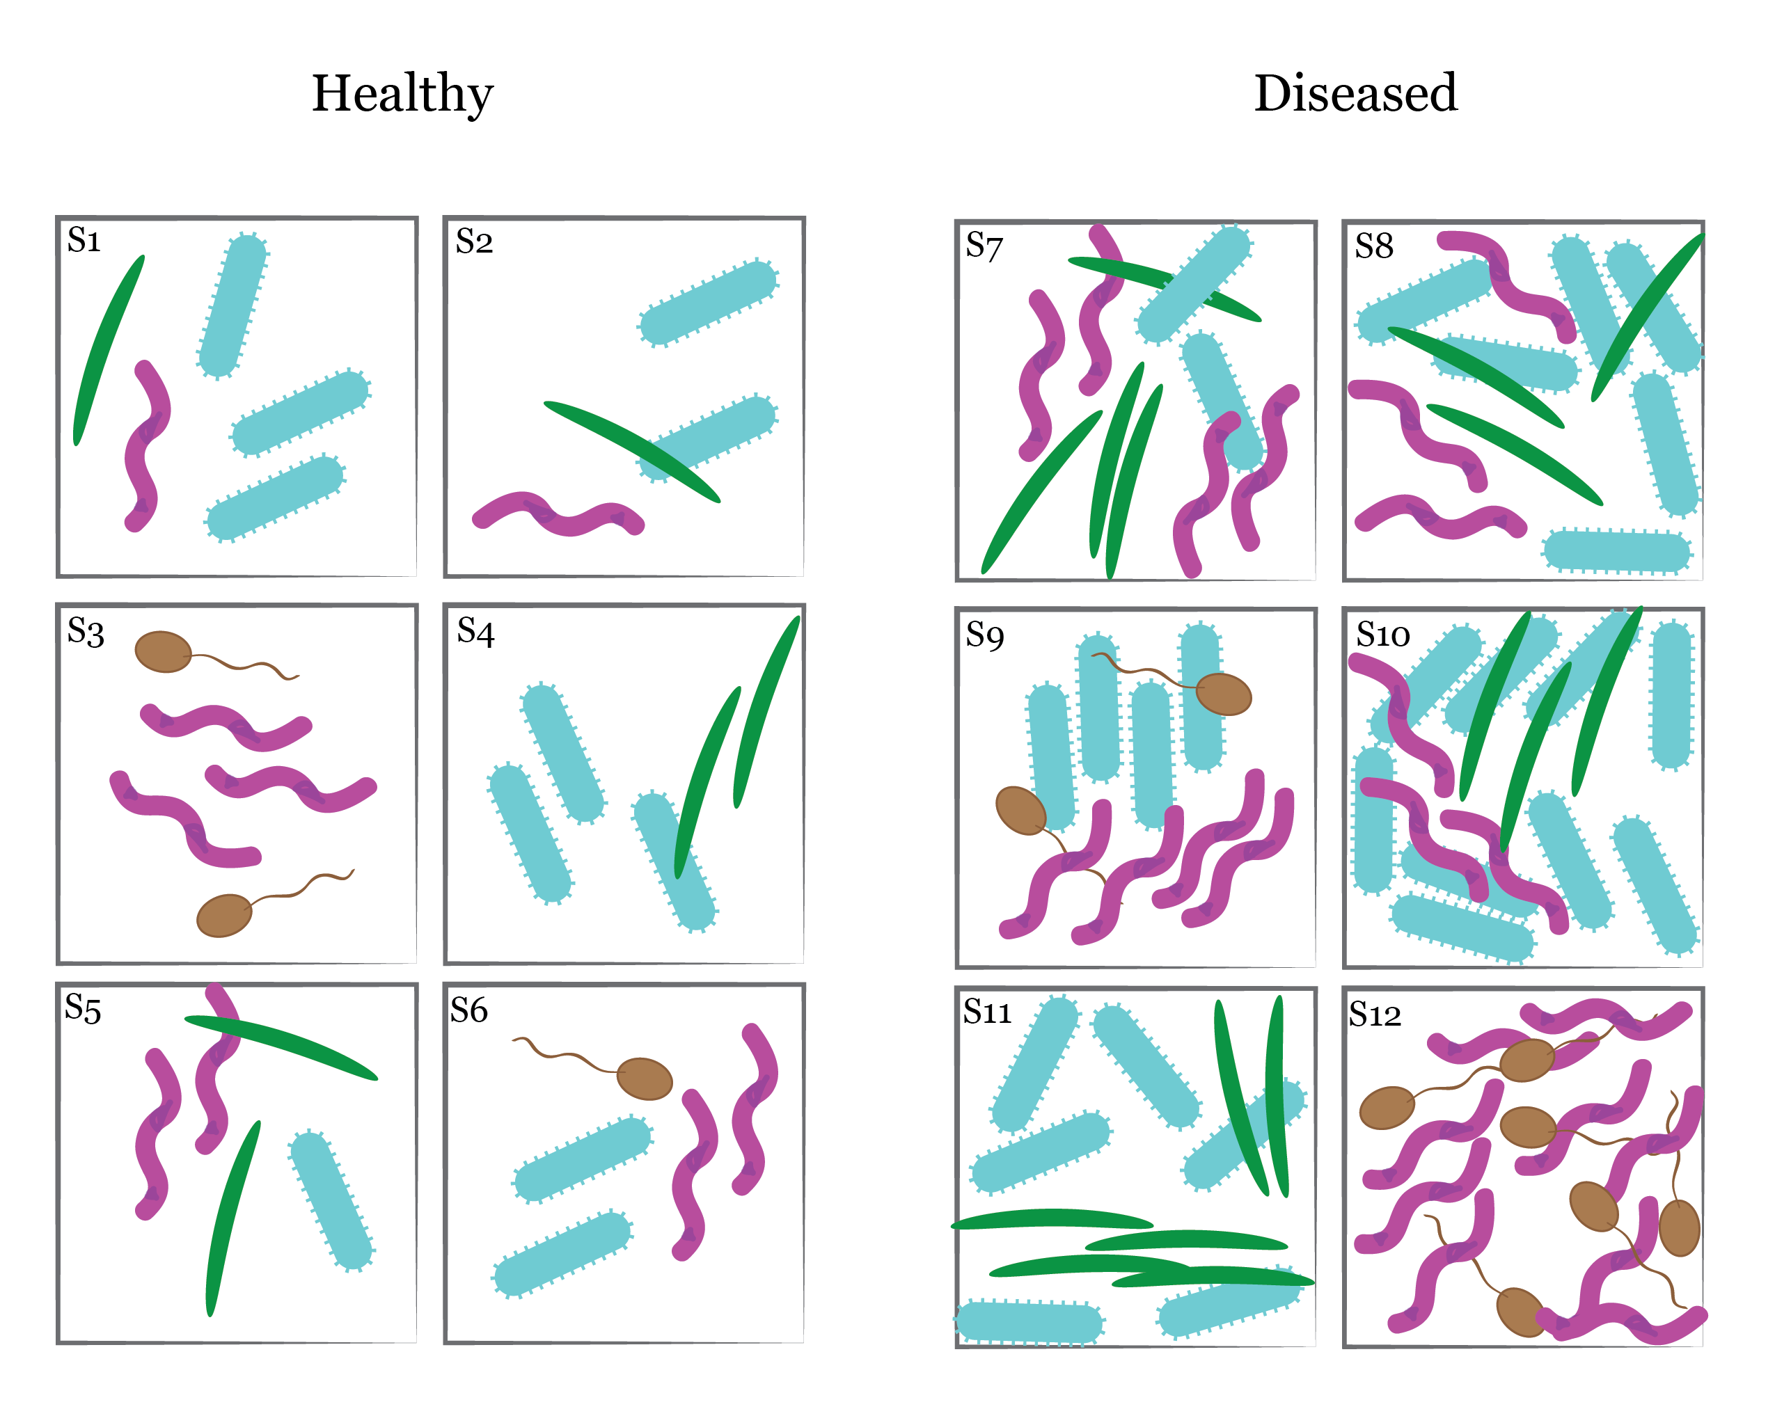

Slide 7
Competitive exclusion?

Slide 8
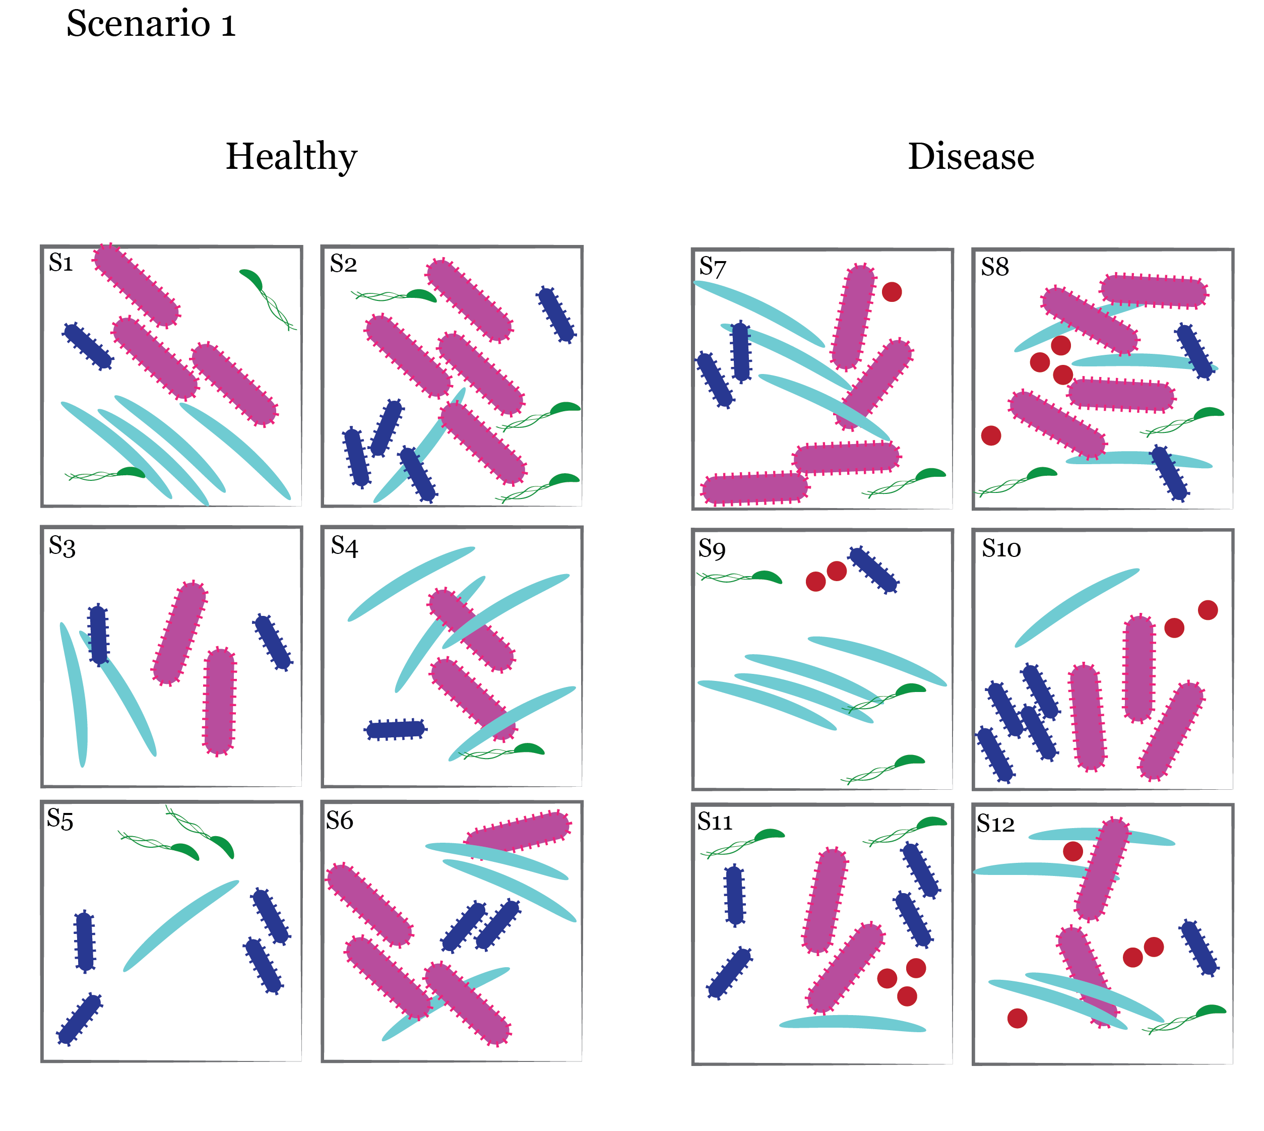

Slide 9
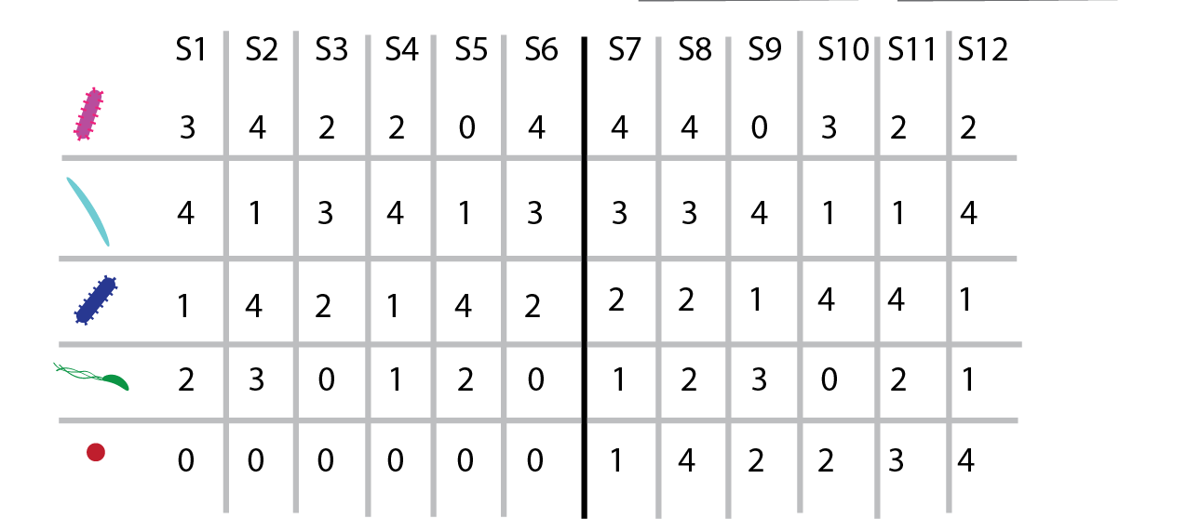
Specific Pathogen
Healthy
Diseased

Slide 10
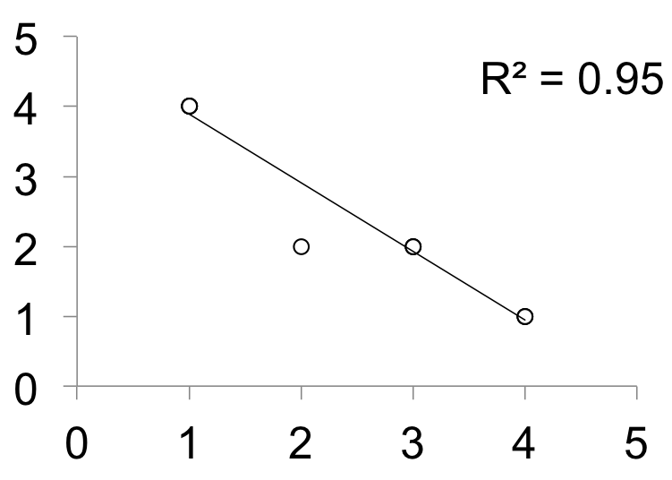
Source: Mike Jones (CC Share-alike 3.0)
Notes:
Details on the image:
This is a Creative Commons image from Mike Jones.
Image URL: https://commons.wikimedia.org/wiki/File:Koch%27s_Postulates.svg

Slide 11
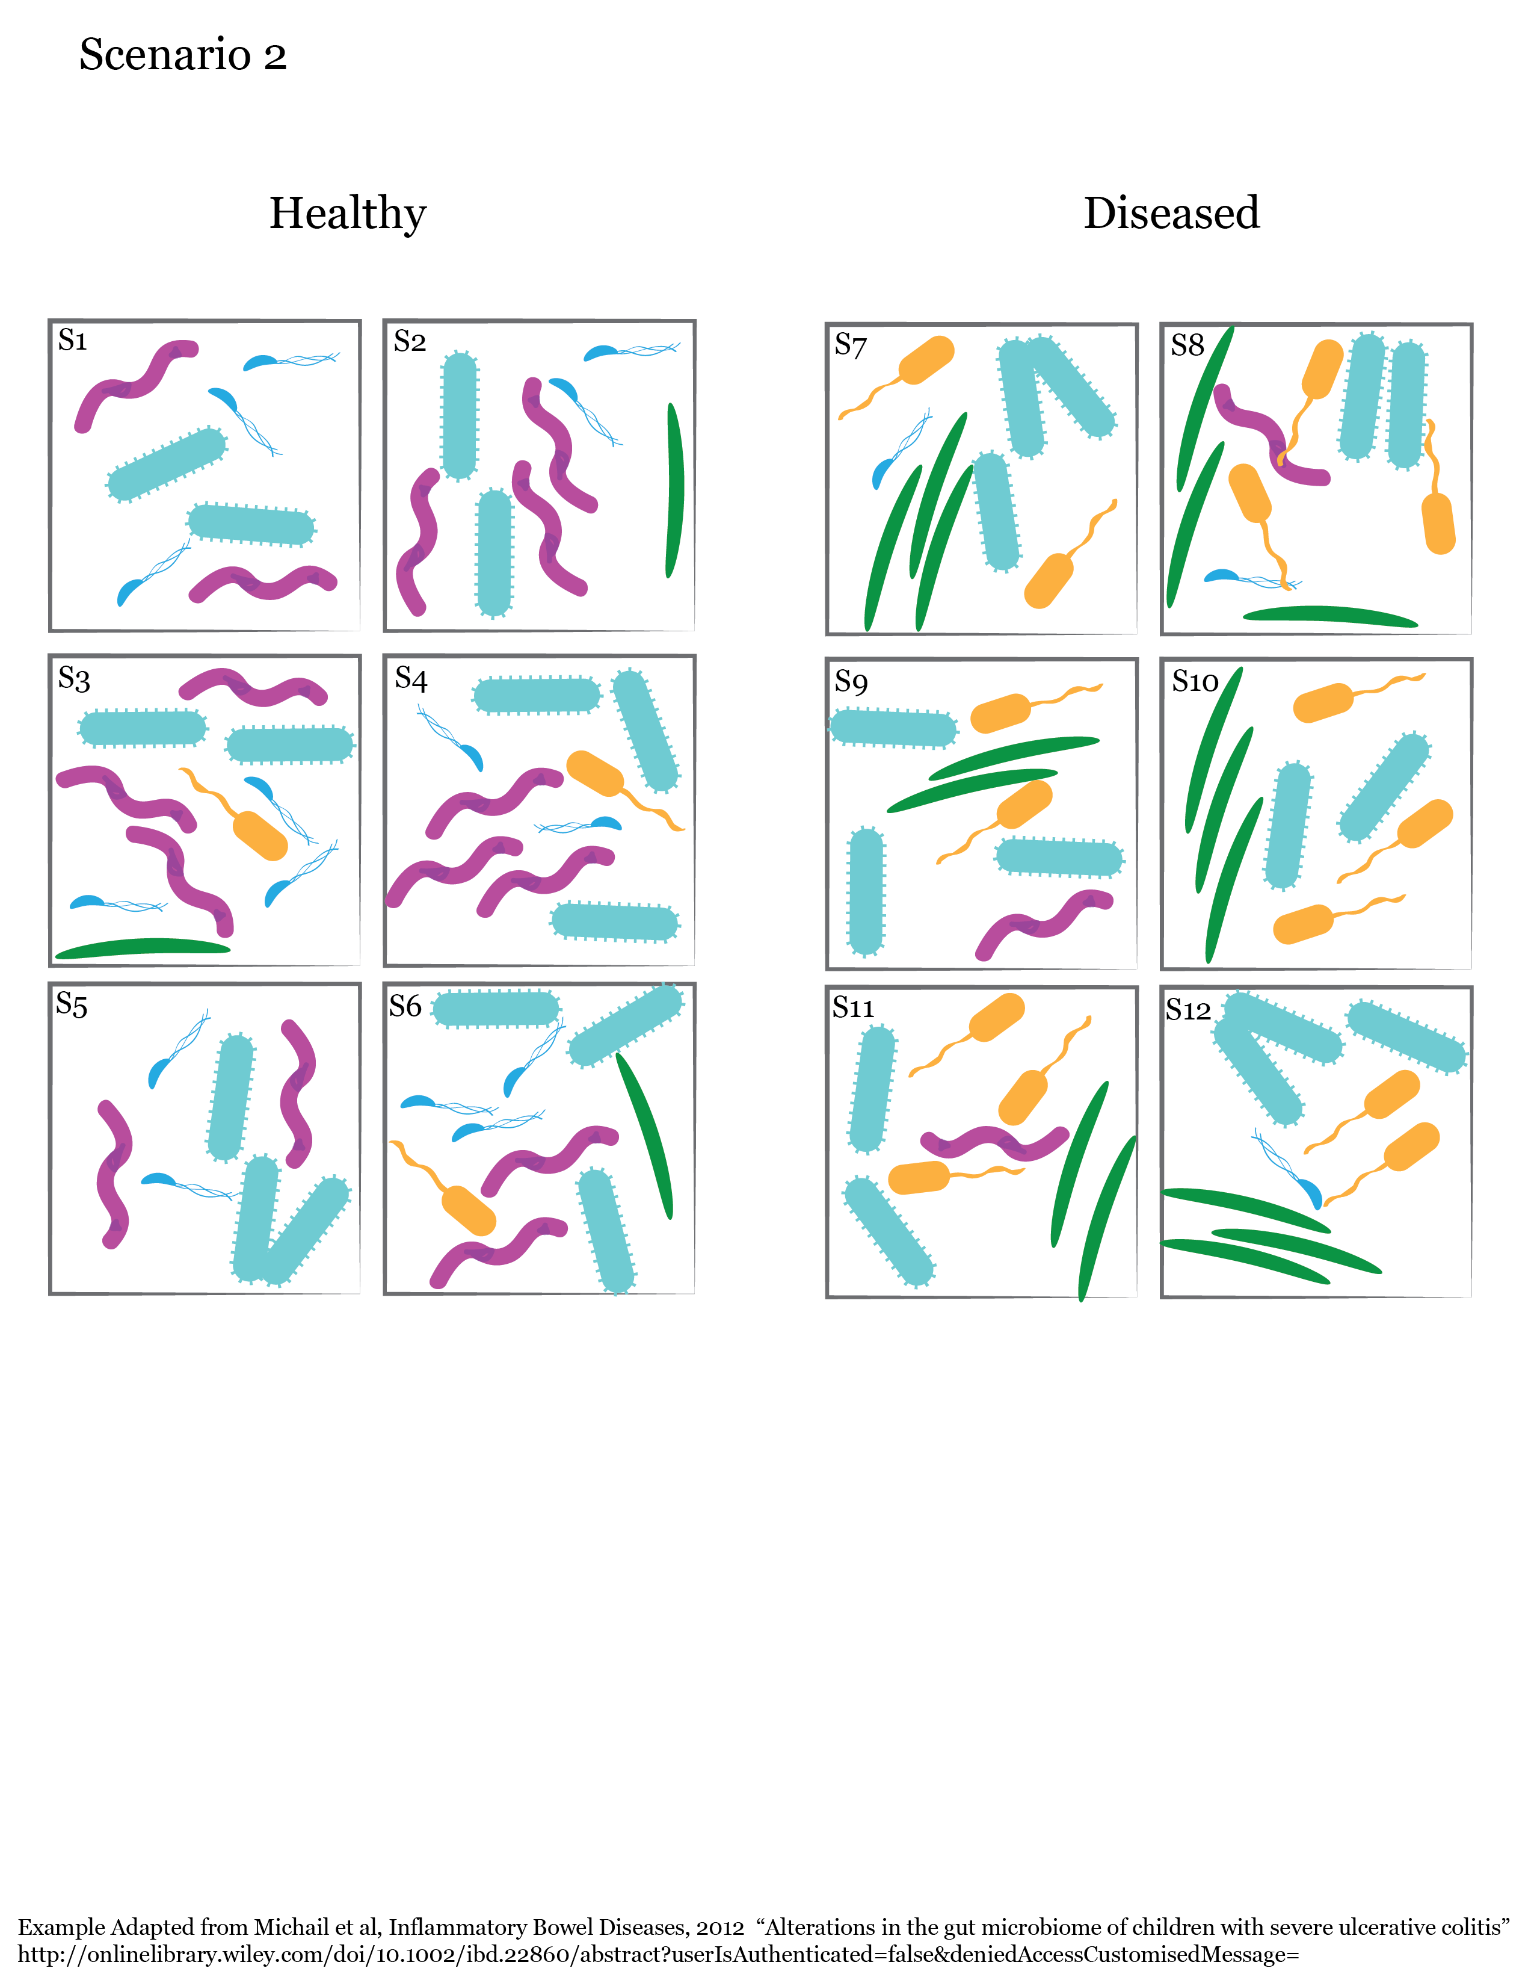
Measuring microbiomes:
β Diversity

Slide 12
Measuring microbiomes:
β Diversity

Slide 13
Measuring microbiomes:
β Diversity
1st goal:
Generate a measure that represents how different the
communities in each sample or environment are.

Slide 14
Measuring microbiomes:
Alpha vs. Beta Diversity
Alpha diversity:
Diversity in a particular environment or sample
Example: How many species (or how much
biodiversity) are in S2 and S7, considered
separately
Beta diversity:
Turnover or difference in species across a
landscape
Example: How similar are the species in S2
to those present in S7?
Whittaker, R. H. Evolution and Measurement of Species Diversity. Taxon 21, 213, doi:10.2307/1218190 (1972)

Slide 15
Measuring microbiomes:
β Diversity
1st goal:
Generate a measure that represents how different the
communities in each sample or environment are.

Slide 16
Measuring microbiomes:
β Diversity
1st goal:
Generate a measure that represents how different the
communities in each sample or environment are.

Slide 17
Measuring microbiomes:
β Diversity distance matrix
Beta-diversity distance matrix
S2 S4 S7
S2
S4
S7
0.0
0.13
0.66
0.13
0.0
0.60
0.66
0.60
0.0

Slide 18
Measuring microbiomes:
β Diversity distance matrix
Beta-diversity distance matrix
S2 S4 S7
S2
S4
S7
0.0
0.13
0.0
0.66
0.60
0.0

Slide 19
Measuring microbiomes:
β Diversity
Quantitative vs. Qualitative Beta-diversity measures:
Qualitative measures count presence/absence of species
Quantitative measures account for abundance
Phylogenetic measure vs. non-Phylogenetic measures:
non-Phylogenetic measures treat all species/OTUs equally
Phylogenetic measures weight species by their evolutionary relationships

Slide 20
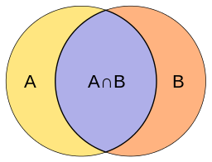
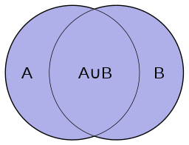
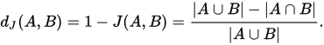
Measuring microbiomes:
β Diversity
How should we measure differences between our communities?
Count how many types are shared vs. unique?

Slide 21
Healthy
Diseased

Slide 22
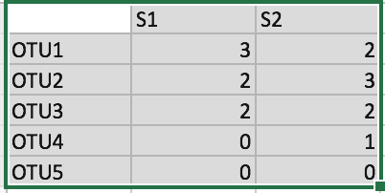
Measuring microbiomes:
β Diversity
Jaccard distance(s1,s2): compares shared vs. unique
OTUs.
S1 and S2 share 3 of 4 OTUs, so they differ
in only 1 of 4 OTUs, or 0.25
Inter-
section
Union

Slide 23
Measuring microbiomes:
β Diversity
Jaccard distance(s1,s2): compares shared vs. unique
OTUs.
More formally:
The intersection of S1 and S2 has
3 OTUs (OTU1,OTU2,OTU3)
The union of S1 and S2 has 4 OTUs (OTU1,OTU2,
OTU3,OTU4)
So we have a Jaccard distance of (4-3)/4 =
¼ = 0.25
Inter-
section
Union

Slide 24
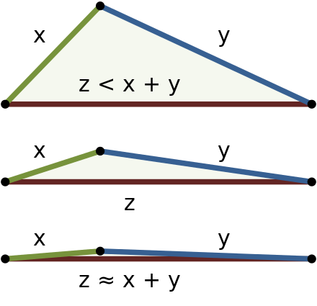
Measuring microbiomes:
Triangle inequality
For a measure of community dissimilarity
to be a distance, it must fulfill the
triangle inequality:
Phrased in terms of some proposed
distance d:

Slide 25
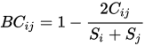
Bray-Curtis Dissimilarity
Bray-Curtis dissimilarity (s1,s2):
Sum of lesser
value of each
pair of species
shared between sites
S_{i} = 7
S_{j} = 8
Total OTUs
Counted at site i
Total OTUs
Counted at site j
Let’s call S1 i and S2 j
C_{ij} = min(3,2) + min(2,3) + min(2,2) = 2 + 2 + 2 = 6
So 2C_{ij} = 12
and the Bray-Curtis divergence Bc_{ij} = 12/15 = 4/5 = 0.80

Slide 26
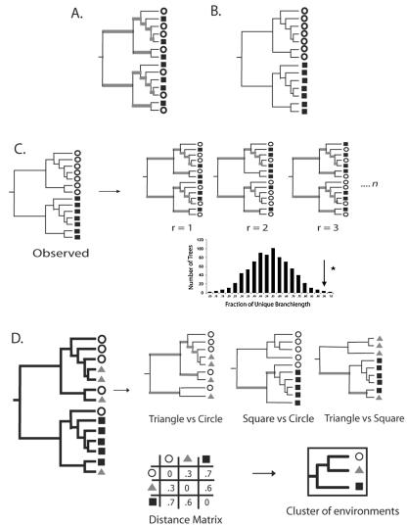
Unweighted UniFrac (Qualitative, Phylogenetic)
Source: Lozupone and Knight,AEM, 2005

Slide 27
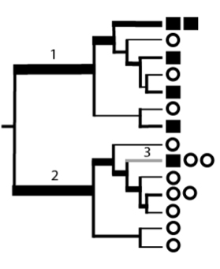
Weighted UniFrac (Quantitative, Phylogenetic)
Bacteria in this group are
mostly represented in the
square environment
Bacteria in this group are
mostly represented in the
circle environment
Source: Lozupone and Knight,AEM, 2005

Slide 28
Measuring microbiomes:
β Diversity distance matrix
Beta-diversity distance matrix
S2 S4 S7
S2
S4
S7
0.0
0.13
0.66
0.13
0.0
0.60
0.66
0.60
0.0
How can we represent complex distance matrices
In a readable form?
Or, how can we represent high-dimensional data
In fewer dimensions while losing as little information
As possible?

Slide 29
Measuring microbiomes:
Principal Coordinates Analysis (PCoA)
Distances
Map
Mexico Highway 1

Slide 30
Measuring microbiomes:
Principal Coordinates Analysis (PCoA)
Beta-diversity distance matrix
Map of sample similarity (PCoA plot)
S2
S2 S4 S7
S2
S4
S7
0.13
0.66
0.0
S4
0.13
0.0
0.60
0.66
0.60
0.0
S7

Slide 31
Measuring microbiomes:
Principal Coordinates Analysis (PCoA)
BUT, no 2d or 3d map fully captures
the community distances….
Just as no flat map perfectly captures
the area, shape, and relative distances
of countries on the earth.

Slide 32
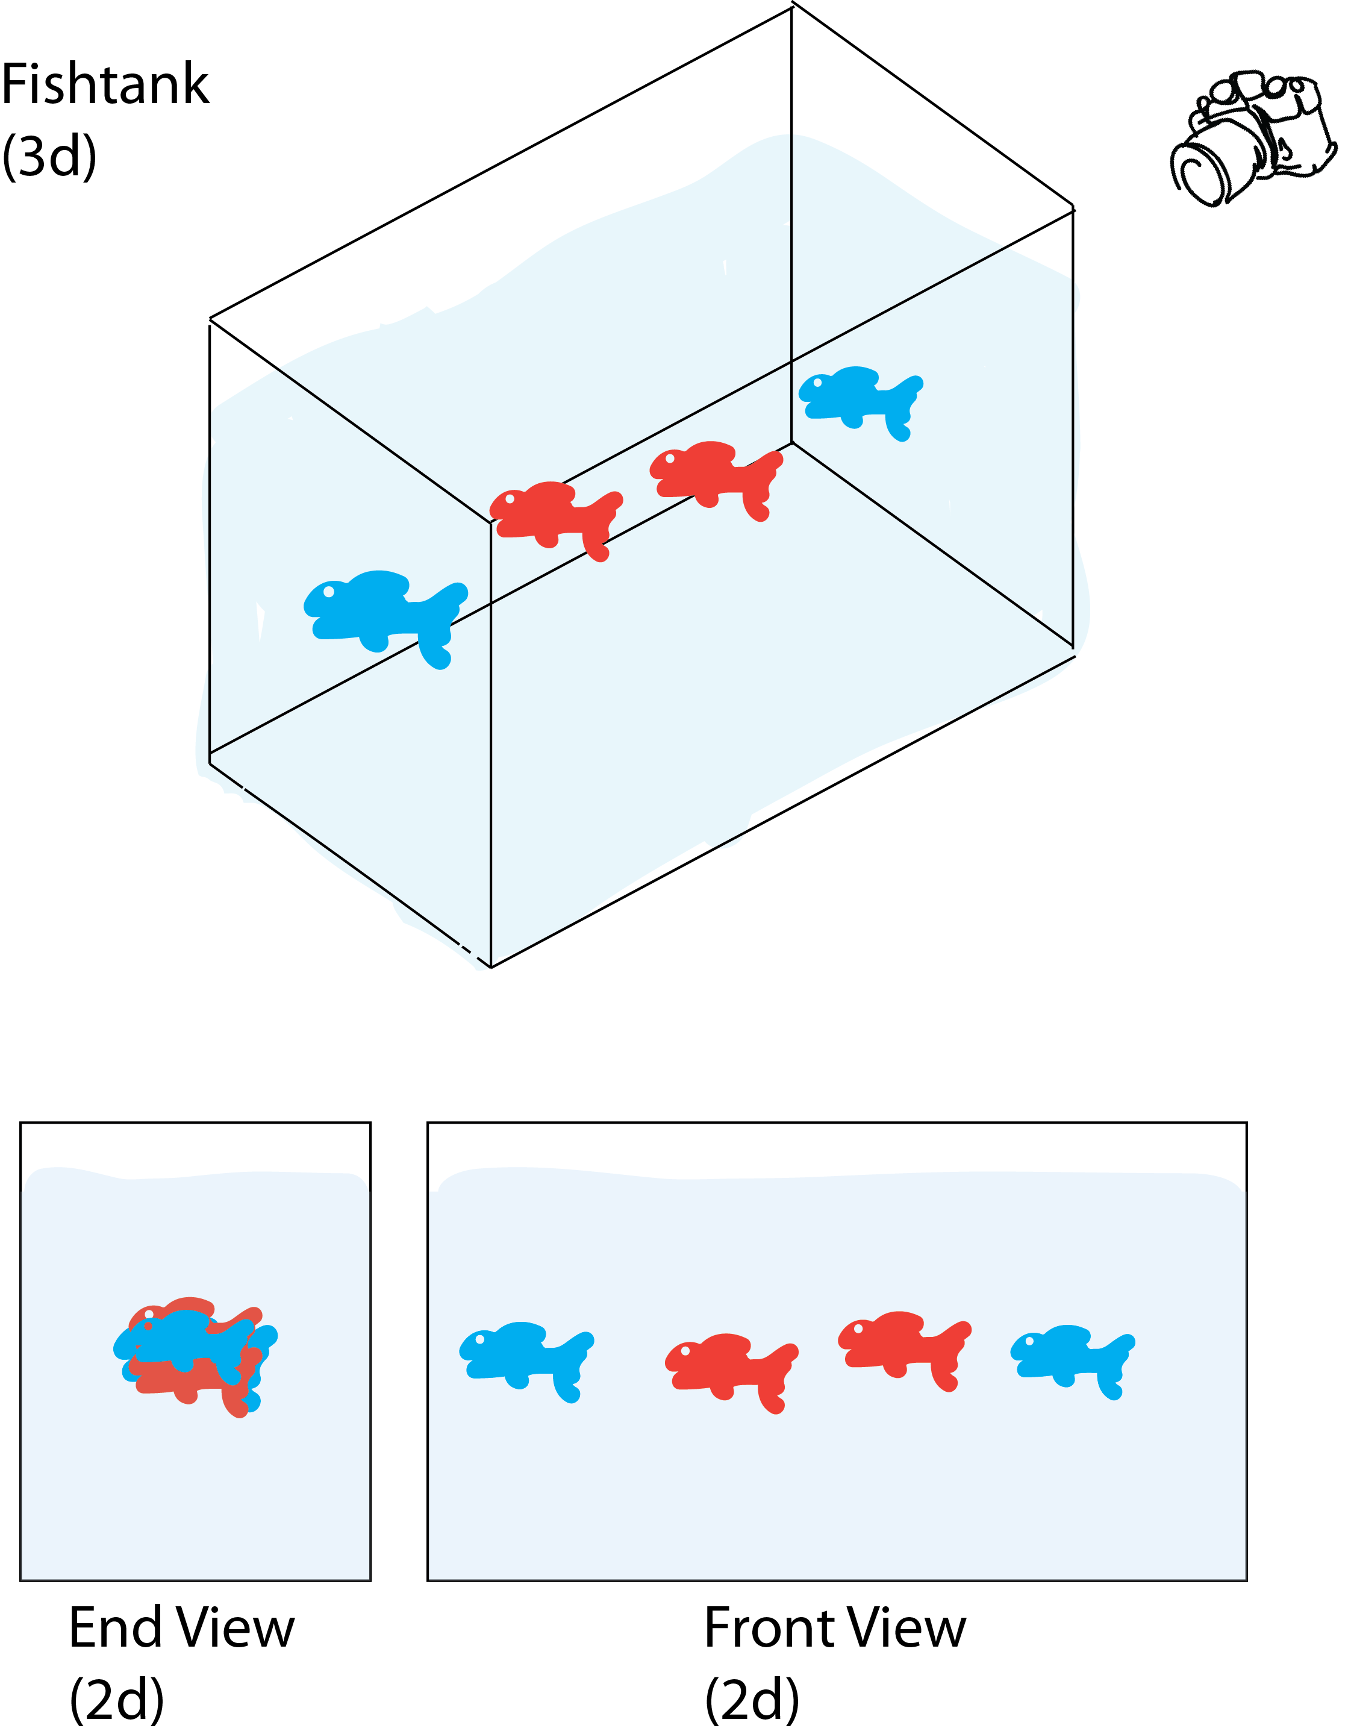
Measuring microbiomes:
Principal Coordinates Analysis (PCoA)
Beta-diversity distance matrix
S2 S4 S7
S2
S4
S7
0.0
0.13
0.0
0.66
0.60
0.0

Slide 33
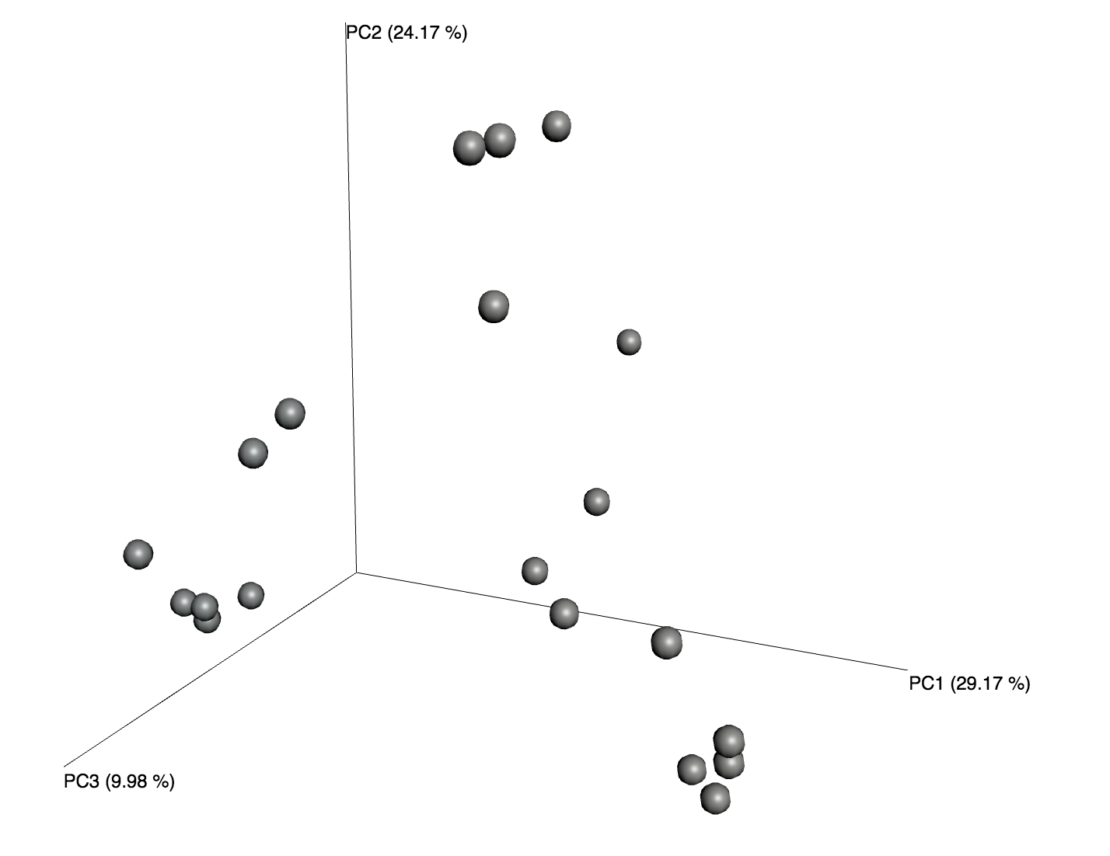
Measuring microbiomes:
Principal Coordinates Analysis (PCoA)

Slide 34
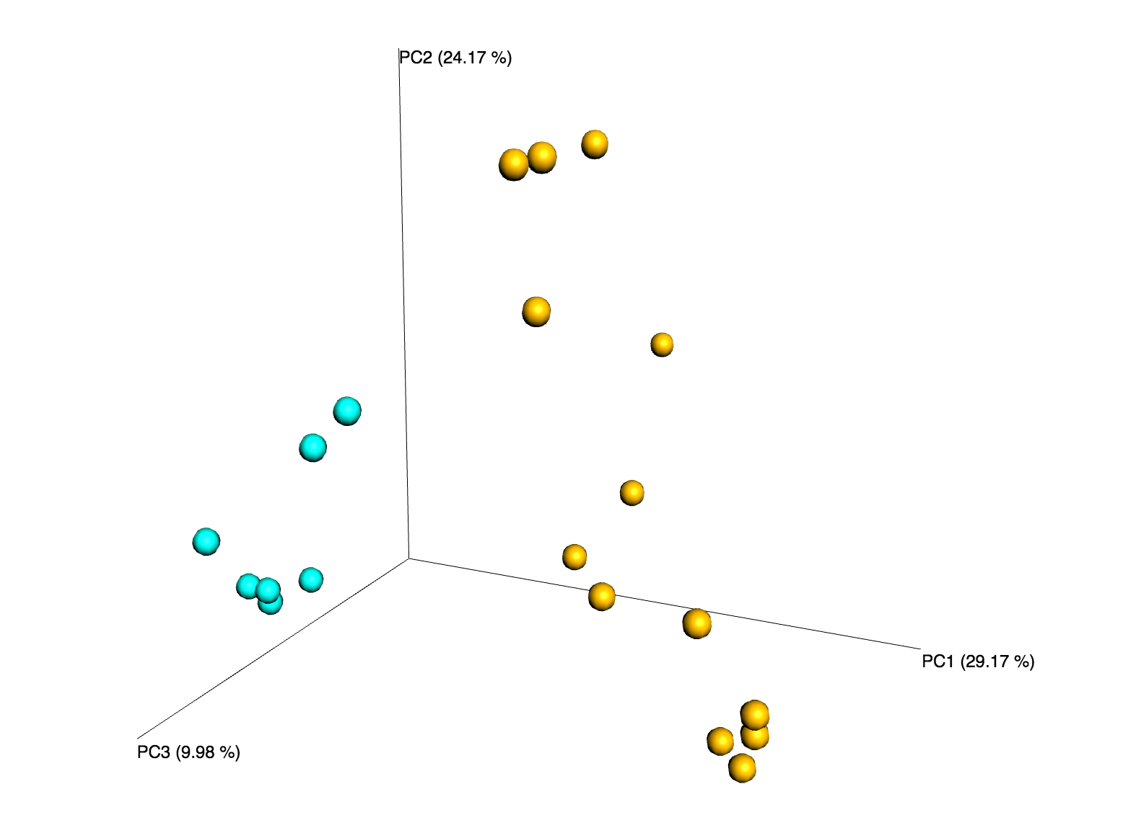
Measuring microbiomes:
Principal Coordinates Analysis (PCoA)

Slide 35
Measuring microbiomes:
Alpha vs. Beta Diversity
Alpha diversity:
Diversity in a particular environment or sample
Example: How many species (or how much
biodiversity) are in S2 and S7, considered
separately
Beta diversity:
Turnover or difference in species across a
landscape
Example: How similar are the species in S2
to those present in S7?
Whittaker, R. H. Evolution and Measurement of Species Diversity. Taxon 21, 213, doi:10.2307/1218190 (1972)

Slide 36
Alpha diversity: richness and evenness
Richness: diversity of species or OTUs within a given sample

Slide 37
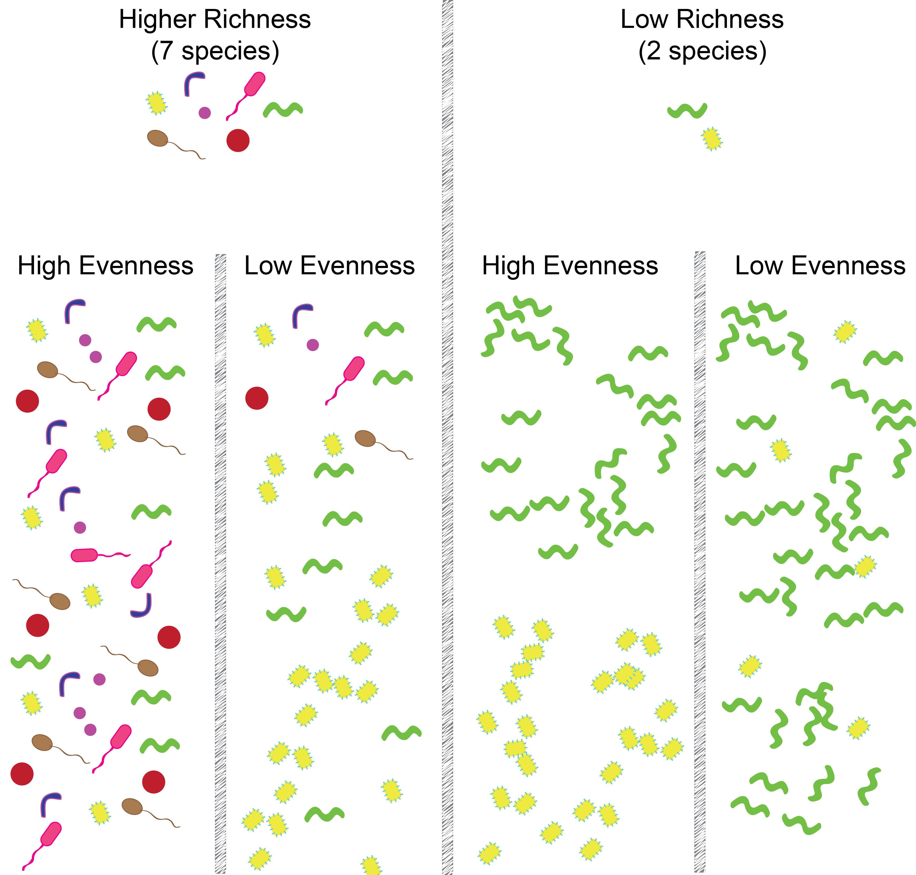
Alpha diversity: richness and evenness
Richness: diversity of species or OTUs within a given sample

Slide 38
Observed species – simply the number of species observed Chao1- number of species observed, attempting to correct for sampling effort
Alpha diversity: common measures of richness

Slide 39
Alpha diversity: common measures of richness
5 species

Slide 40
Alpha diversity: common measures of richness
Vs.
5 species
Also 5 species!

Slide 41
Faith’s Phylogenetic Diversity (PD) – portion of reference evolutionary tree represented
Alpha diversity: common measures of richness
Vs.
5 species
Also 5 species!

Slide 42
Faith’s Phylogenetic Diversity (PD) – portion of reference evolutionary tree represented
Alpha diversity: common measures of richness
Vs.
5 species
Also 5 species!

Slide 43
Observed species – simply the number of species observed Chao1- number of species observed, attempting to correct for sampling effort Faith’s Phylogenetic Diversity (PD) – portion of reference evolutionary tree represented (weights unrelated species more heavily than close relatives)
Alpha diversity: common measures of richness
It’s good to know the theory, but
in practice these are often (but not always)
highly correlated

Slide 44
Alpha diversity: richness and evenness
Evenness: equal or unequal abundance of microbes in a sample
(“the top 1% of most abundant OTUs account for 70% of sequence reads”)

Slide 45
Alpha diversity: richness and evenness
Evenness: equal or unequal abundance of microbes

Slide 46
Richness: OTU diversity within a sample
Evenness: equal or unequal OTU abundance

Slide 47
Richness: OTU diversity within a sample
Evenness: equal or unequal OTU abundance

Slide 48
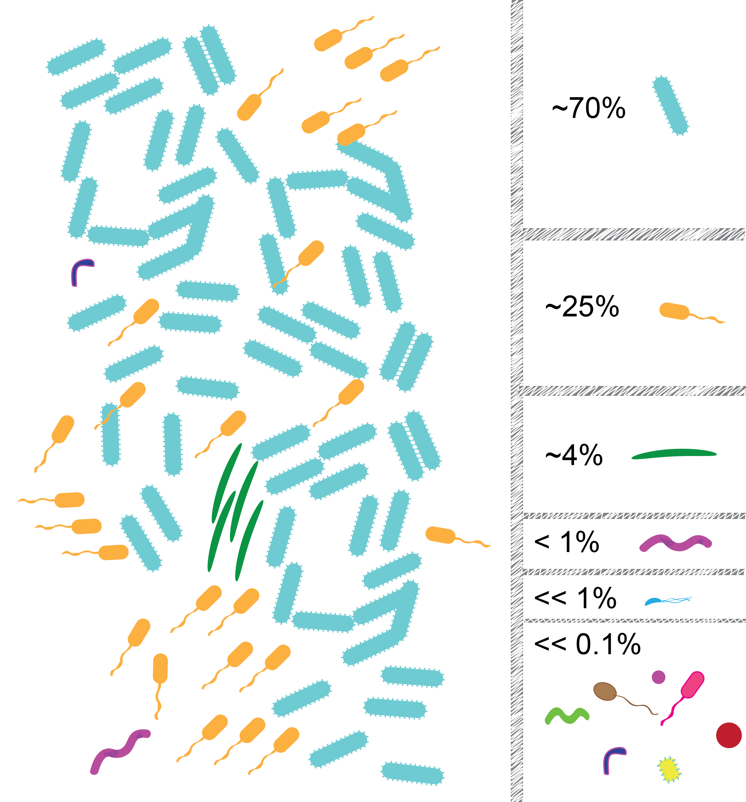

Slide 49
Microbial communities typically have relatively few abundant OTUs, and many rare OTUs

Slide 50
Microbial communities typically have relatively few abundant OTUs, and many rare OTUs (i.e. they are not perfectly even, and counts are far from uniformly distributed across species)

Slide 51
Microbial communities typically have relatively few abundant OTUs, and many rare OTUs (i.e. they are not perfectly even, and counts are far from uniformly distributed across species)

Slide 52
What implications does this
have for microbial community
analysis?
Implication 1:
Until the community is fully
enumerated, deeper sampling
(i.e. more DNA sequences) will
uncover more unique OTUs

Slide 53
Let’s do some (back of the envelope) simulation:

Slide 54
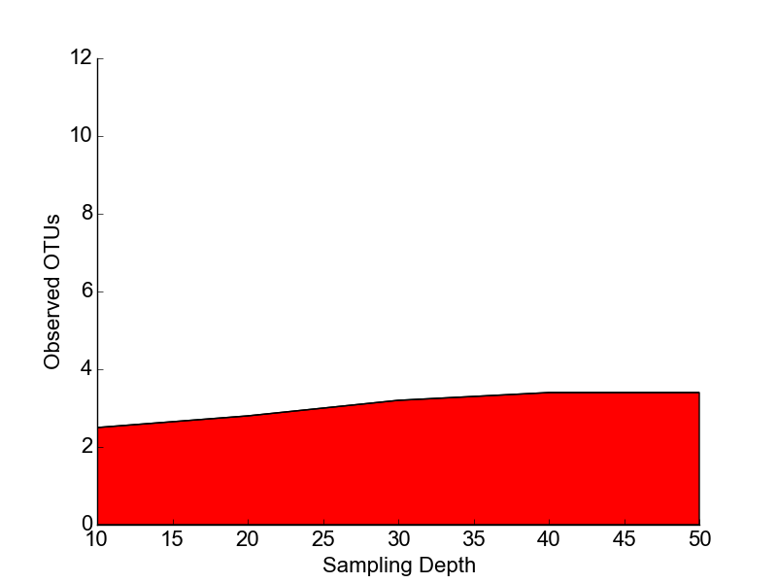
Let’s do some (back of the envelope) simulation:

Slide 55
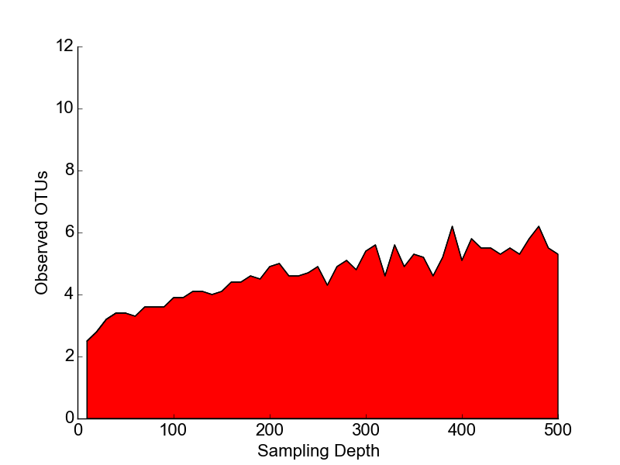
Let’s do some (back of the envelope) simulation:

Slide 56
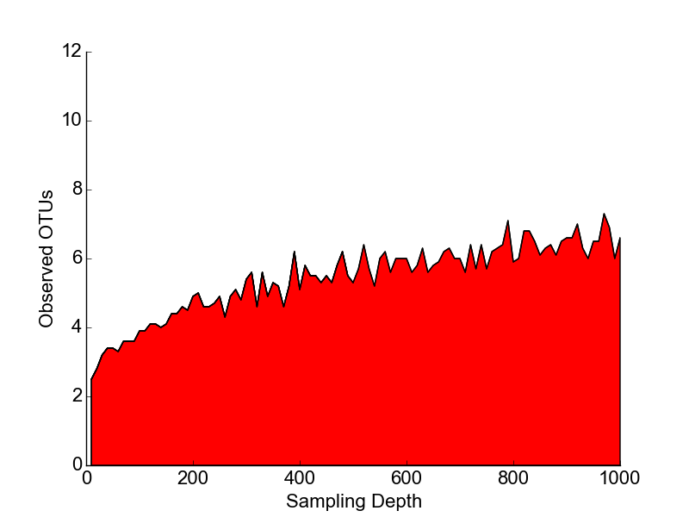
Let’s do some (back of the envelope) simulation:

Slide 57
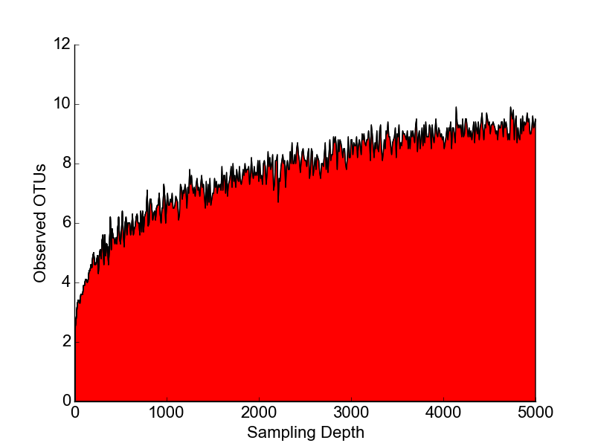
Let’s do some (back of the envelope) simulation:

Slide 58
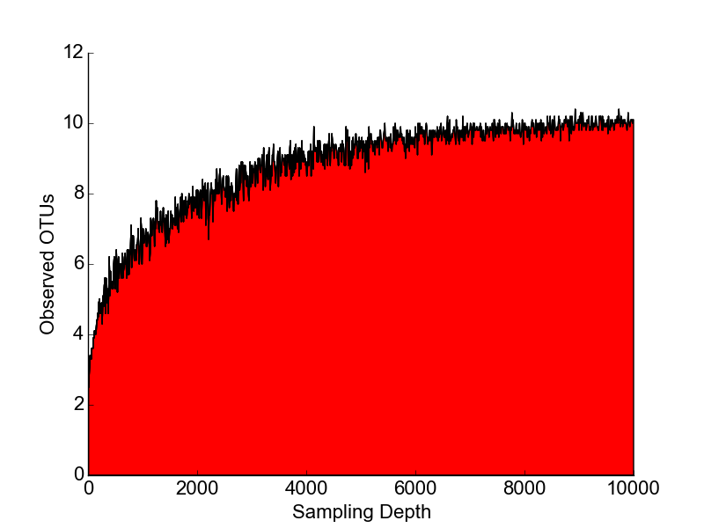
Let’s do some (back of the envelope) simulation:

Slide 59
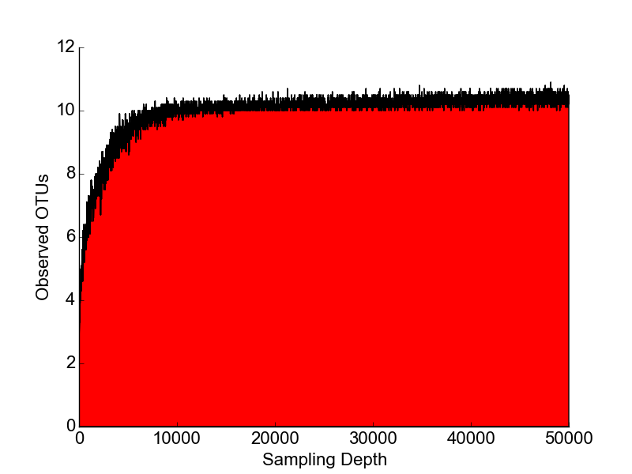
Let’s do some (back of the envelope) simulation:

Slide 60
Implication 1:
Until the community is fully
enumerated, deeper sampling
(i.e. more DNA sequences) will
uncover more unique OTUs

Slide 61
Implication 2:
Depending on whether rare or common
taxa are preferentially shared between
two samples, Beta-diversity will increase or
decrease with sampling depth

